Slide 1
A Data Center
Case Study
Source:
D. Menasce, V.A. Almeida, L.W. Dowdy
Performance by Design: Computer Capacity Planning by Example
Prentice Hall, 2004
by Ulrike Talbiersky, Holger Wichert, Christian Lohrengel, André Augustyniak

Slide 2
Table of Contents:
Introduction
The Data Center
First Model Attempt: Markov Chain
Tasks
Second Model Attempt: Two-Device QN
Cost Analysis

Slide 3
Introduction
Data centers offer a variety of services
Trend: service-based data centers
Problems:
  Compliance with SLA
  default tolerance, privacy, security (...)
Too expensive
How to choose the optimal size?
(→ cost)

Slide 4
The Data Center
Machine-Repair-Model:
M machines (functionally identical)
N repair people
Diagnostic system:
  Detect failures of the machines
  Maintain a queue of machines waiting to be repaired
  Log failure time
  record repair times

Slide 5
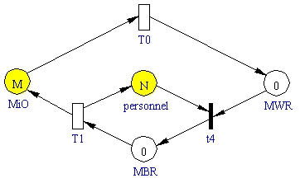
GSPN-Model
(Sharpe)
λ
μ
λ Failure rate
μ Repair rate
MiO Machines in operation
MBR Machines being repaired
MWR Machines waiting to be repaired

Slide 6
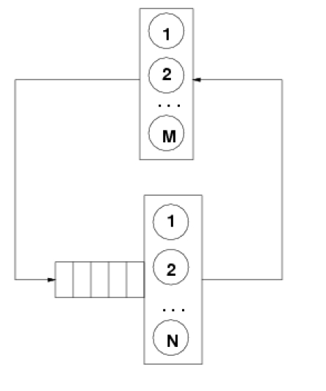
Queueing Model
Machines in operation
Machines waiting to be repaired
Machines being repaired

Slide 7
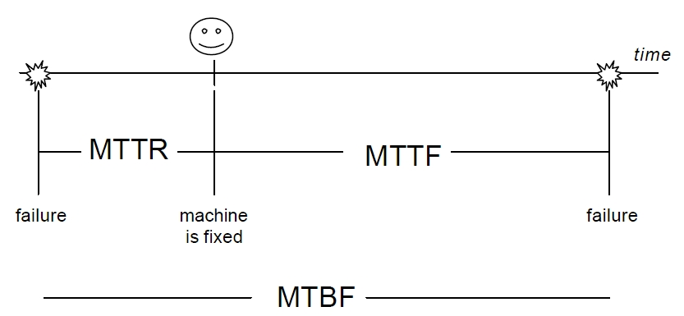
Parameters
λ Failure rate
1/λ MTTF (Mean Time to Failure)
μ Repair rate
1/μ Time to repair a machine
MTTR Mean Time to Repair
MTBF Mean Time Between Failures

Slide 8
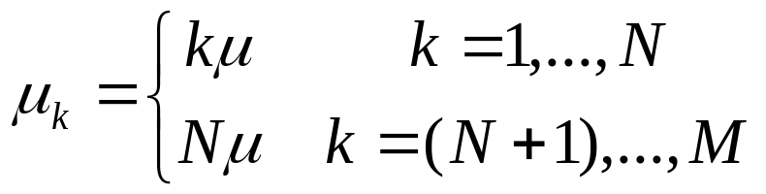
Building a Model
~1~
Example: Markov Chain
k number of failed machines
k →k+1 transition when a machine fails
k →k-1 transition when a machine is repaired
λk = (M-k)λ aggregate failure rate
aggregate repair rate

Slide 9
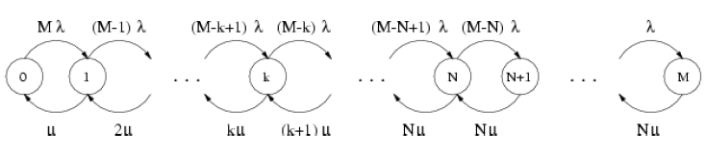
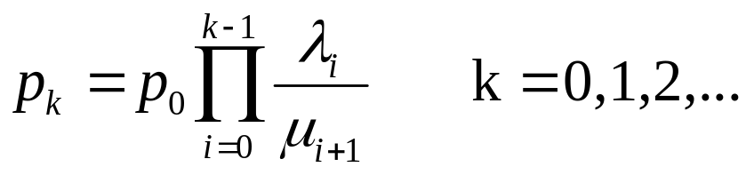
Building a Model
~2~
M-k machines in operation
1-dim. Generalized Birth-Death (GBD)

Slide 10
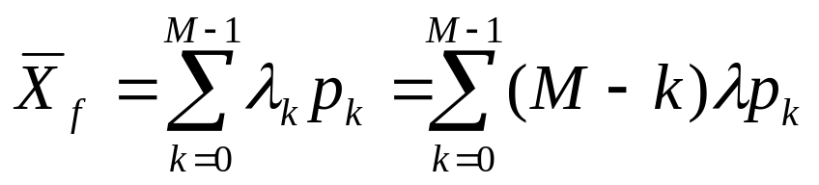
Building a Model
~3~
Average aggregate rate at which machines fail
(which equals average aggregate rate at which
machines are repaired):

Slide 11
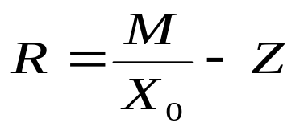
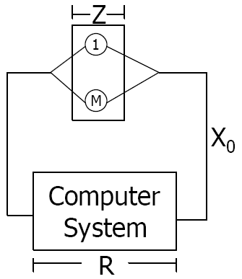

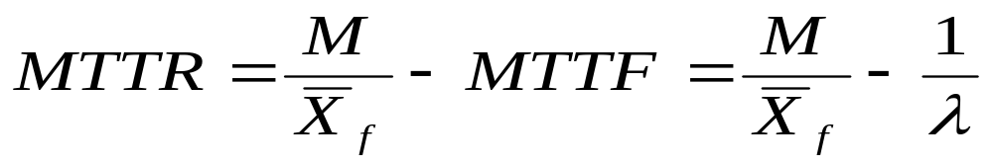
Building a Model
~4~
Interactive Response Time Law:
Client work station ↔ machines in operation
Average think time Z ↔ MTTF
Average response time R ↔ MTTR
System throughput

Slide 12

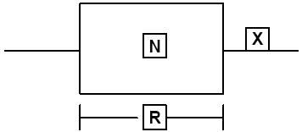

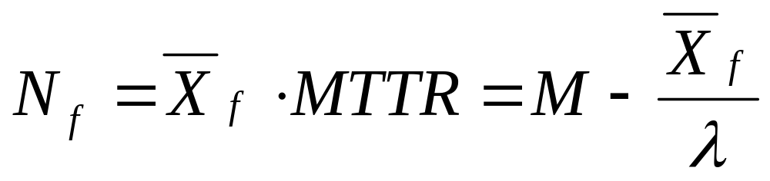
Building a Model
~5~
Little´s Law: (Box of reparation)
R ↔ MTTR
N_{f} = average number of failed machines

Slide 13
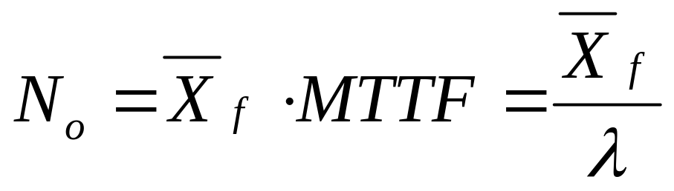

Building a Model
~6~
Little´s Law: (operational machines)
R ↔ MTTF
N_{o} = average number of operational machines

Slide 14
Values for the Example
120 machines
MTTF = 500 min
λ = 0.002 per min
Time to repair a machine = 20 min
μ = 0.05 per min

Slide 15
Task 1
Given is
failure rate of machines λ = 0.002 per min
number of machines M = 120
repair rate of machines μ = 0.05 per min
What is the probability that exactly j machines are operational?

Slide 16
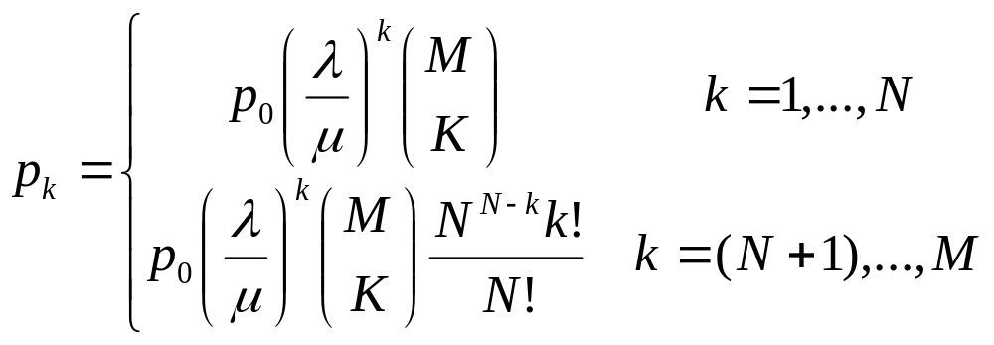
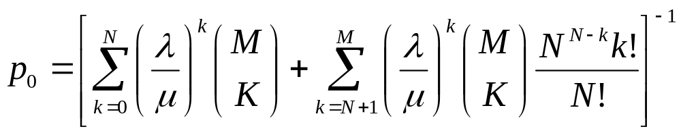
Task 1
Use:
pexactly j machines in operation = p_{M-j}

Slide 17
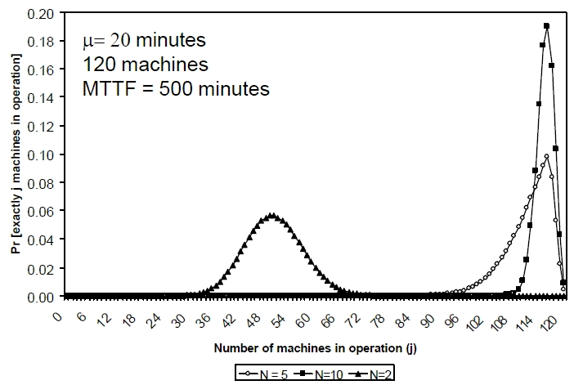
Task 1
N = 2,5,10

Slide 18
Task 2
Given is
failure rate of machines λ = 0.002 per min
number of machines M = 120
number of repair people N
repair rate of machines μ = 0.05 per min
What is the probability P_{j} that at least j
machines are operational ?

Slide 19
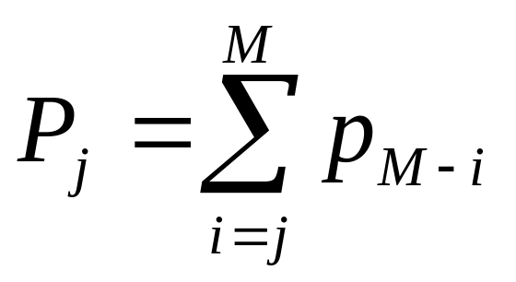
Task 2
Use Task 1 and:
once the personnel becomes overloaded, the system tends towards failure
if M>>N: having extra machines is pointless

Slide 20
Task 3
Given is
failure rate of machines λ = 0.002 per min
number of machines M = 120
wanted probability: P_{j} = 0.9
Time to repair a machine = 20 per min
How many repair people are necessary to guarantee that at least two thirds of the machines are operational with P_{j} = 0.9 ?

Slide 21
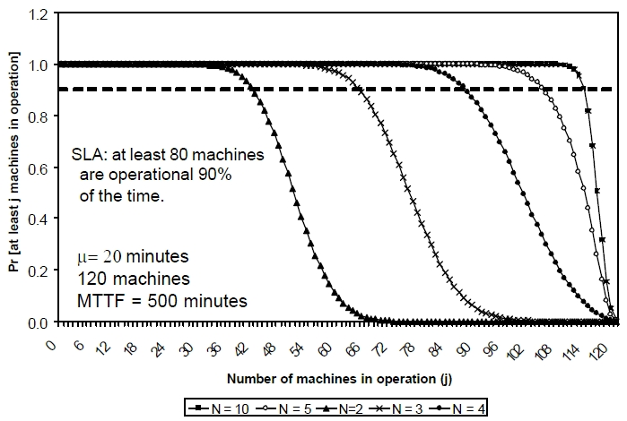
Task 2,3
N = 2,3,4,5,10

Slide 22
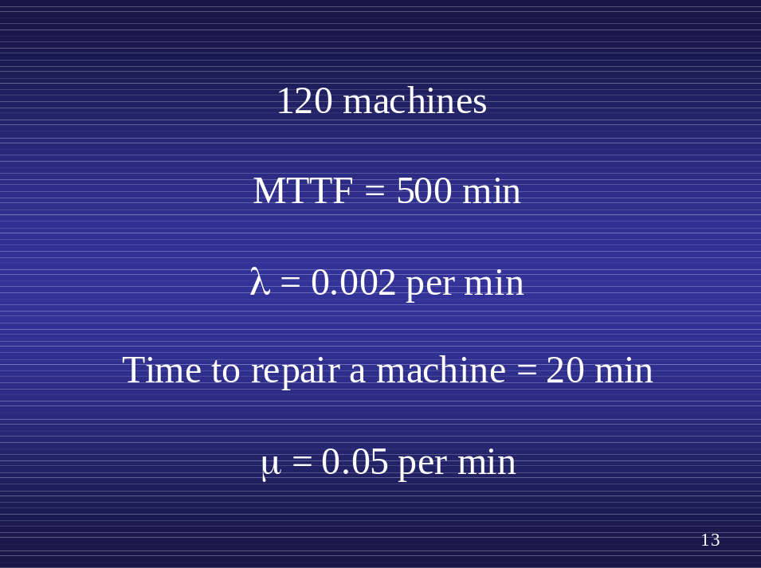
Task 4
Given are the values
What is the effect of the size of the repair team, N, on the MTTR a machine ?

Slide 23
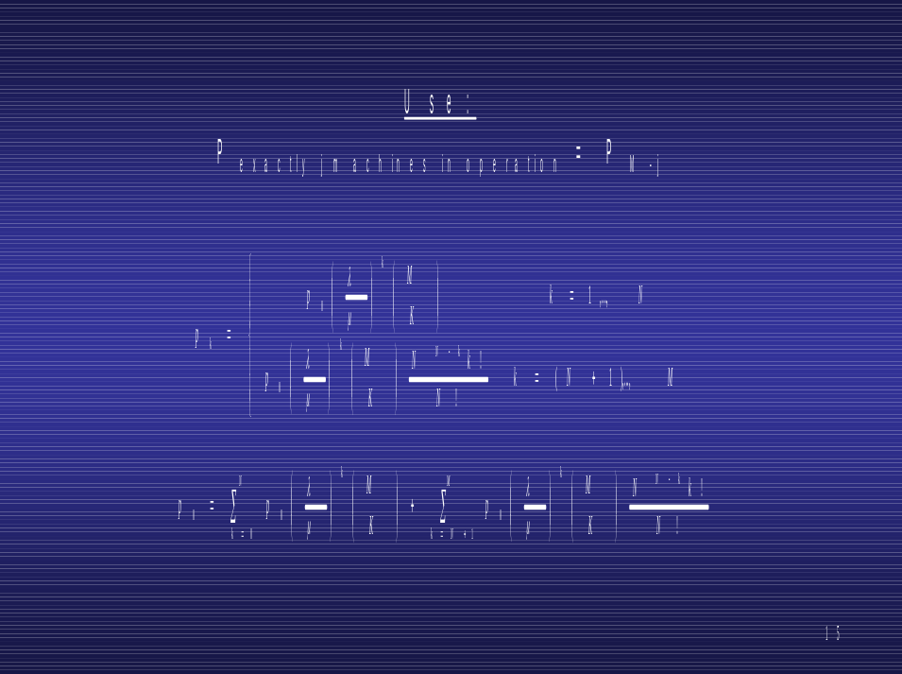
Task 4
computation
1. p₀
2. p_{k}

Slide 24
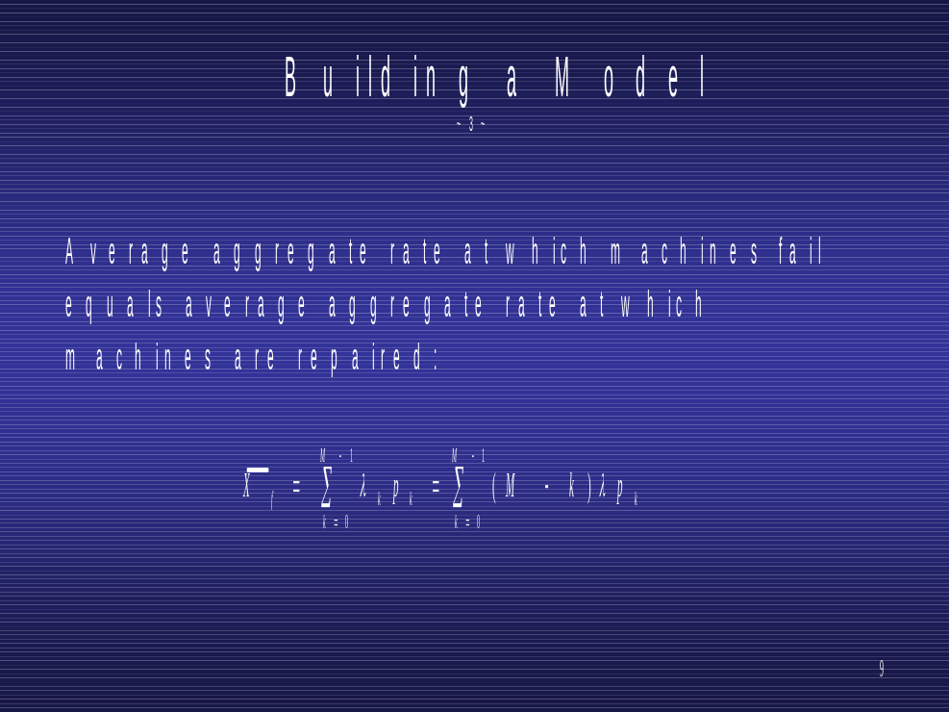

Task 4
computation
1. p₀
2. p_{k}

Slide 25
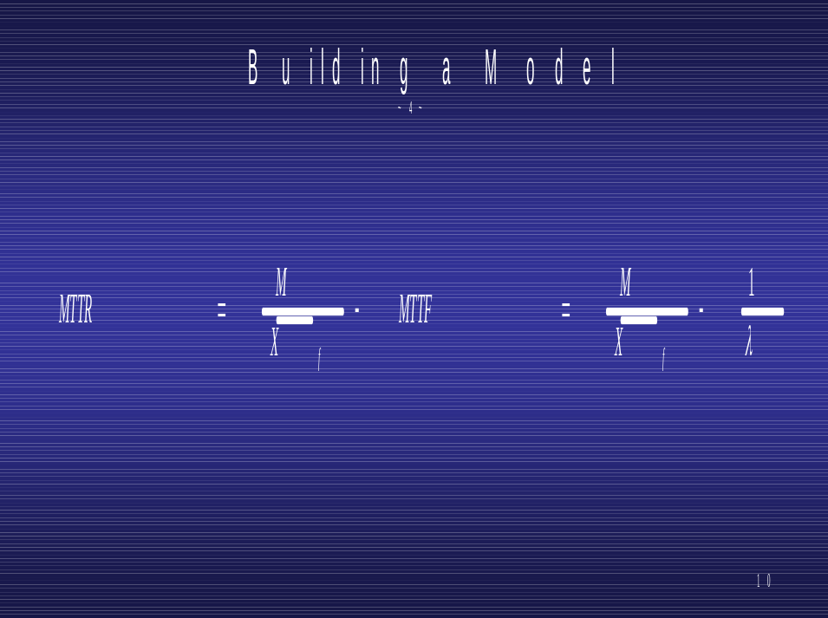
Task 4
computation
1. p₀
2. p_{k}
4. MTTR

Slide 26
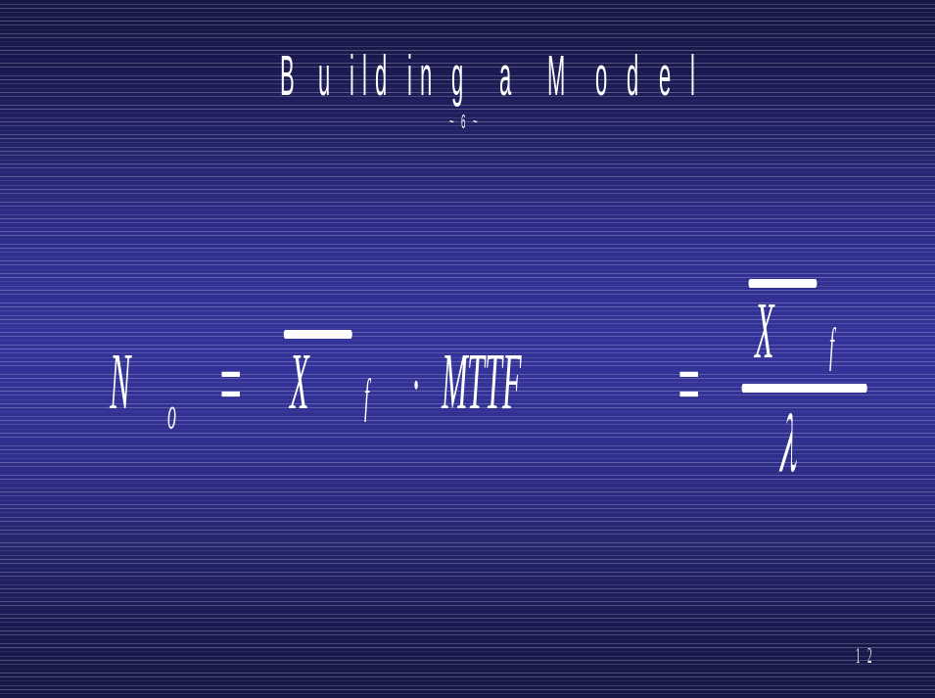
Task 4
computation
1. p₀
2. p_{k}
4. MTTR
5. N_{o}

Slide 27
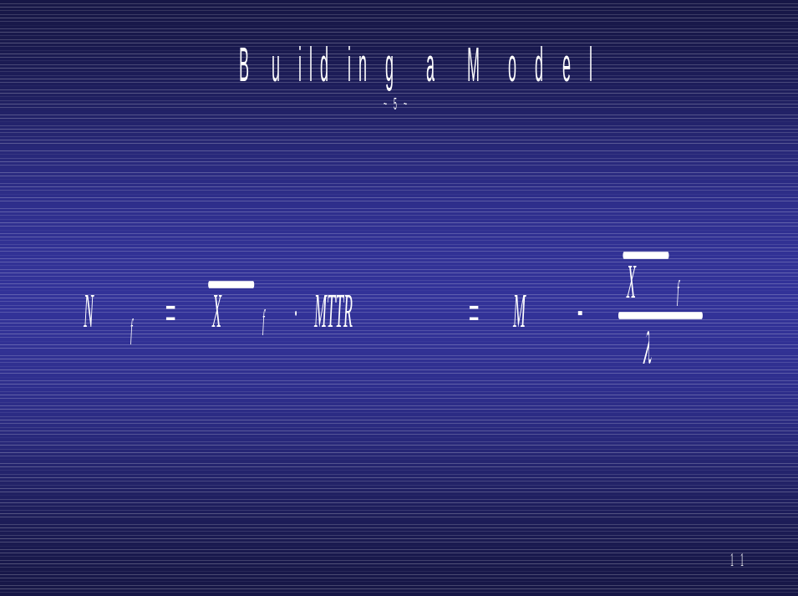
Task 4
computation
1. p₀
2. p_{k}
4. MTTR
5. N_{o}
6. N_{f}

Slide 28
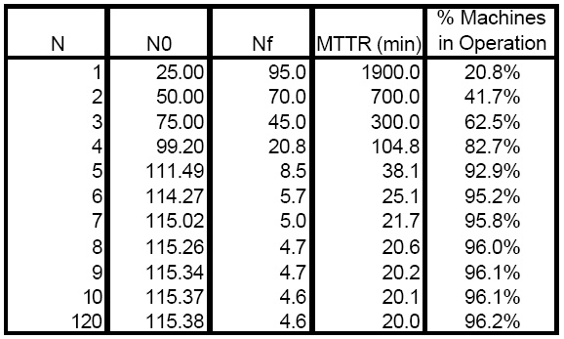
Task 4
Effect of Number of Repair People
N repair people
N_{O} average number of operational machines
N_{f} average number of failed machines
MTTR Mean Time to Repair

Slide 29
Task 4
number of repair people is increased beyond 5, further decreases in the MTTR is minimal
with 5 repair people:
111 machines operational
down time of 38 minutes
(MTTR = 38 min: 20 min repair, 18 min wait)

Slide 30
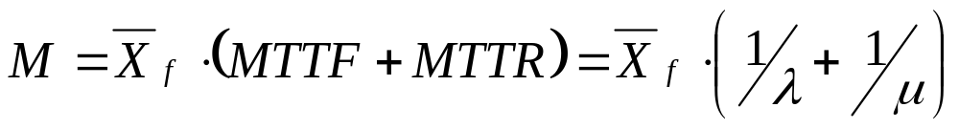
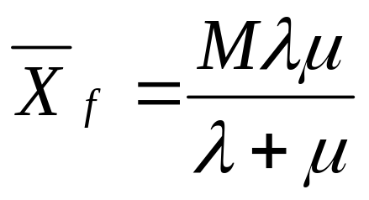
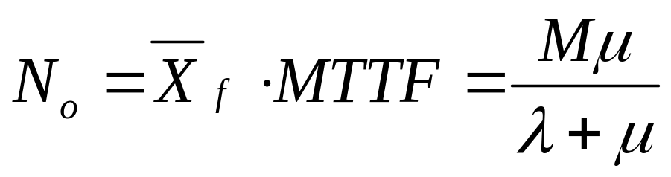
Task 4
case N = M =120:

Slide 31
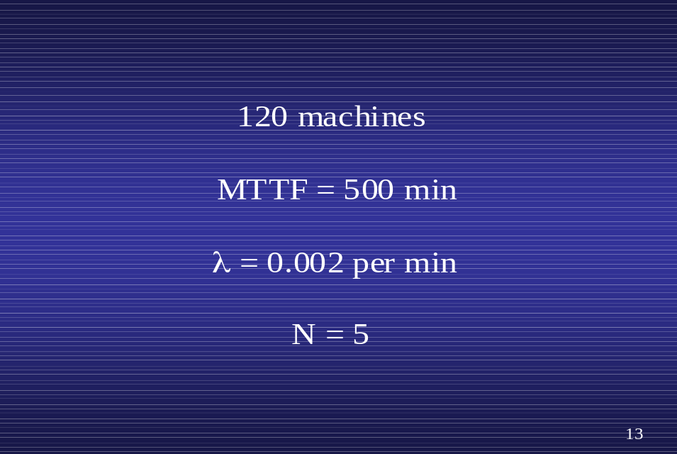
Task 5
Given are the values
What is the effect of a repair person´s skill level on the overall down time ?

Slide 32
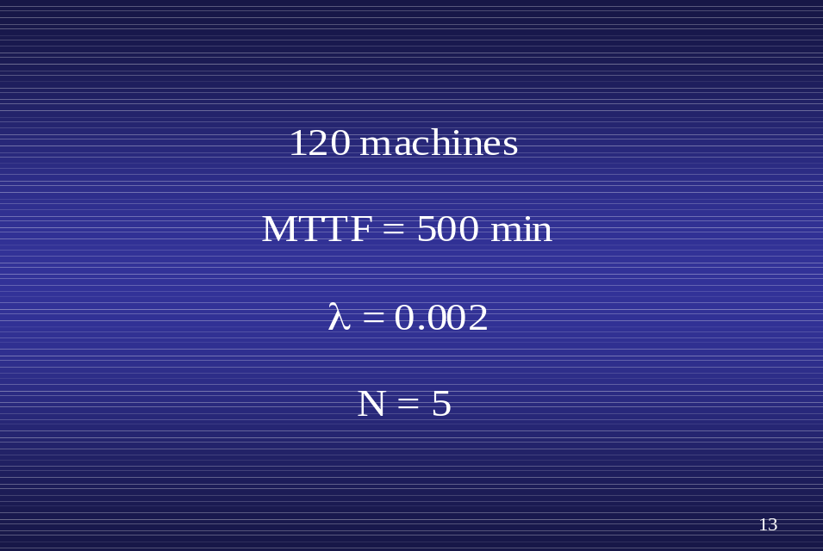
Task 5
Given are the values
How does the skill level affect the percentage of operational machines ?

Slide 33
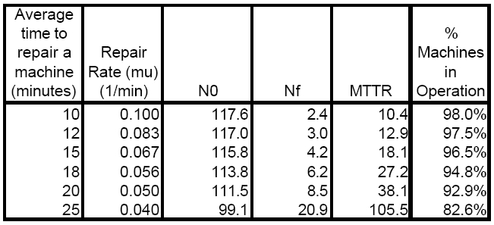
Task 5
Effect of the Repair Rate
N_{O} average number of operational machines
N_{f} average number of failed machines
MTTR Mean Time to Repair

Slide 34
Second Modeling Attempt
~1~
The Failure-recovery-model can also be modeled by a two-device QN:
1st device: delay server
(→ Machines in Operation)
2nd device: load-dependent server
(→ repair people)

Slide 35
Second Modeling Attempt
~2~
Delay server:
A fixed machine goes into operation without queuing.
The time a machine is valid depends only on its MTTF.

Slide 36
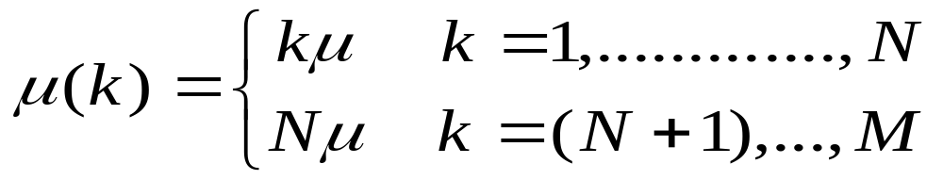
Second Modeling Attempt
~3~
Load-dependent server:
total rate at which machines are repaired (TRMR) depends on:
- number of failed machines k
- number of repair people N
service rate:

Slide 37
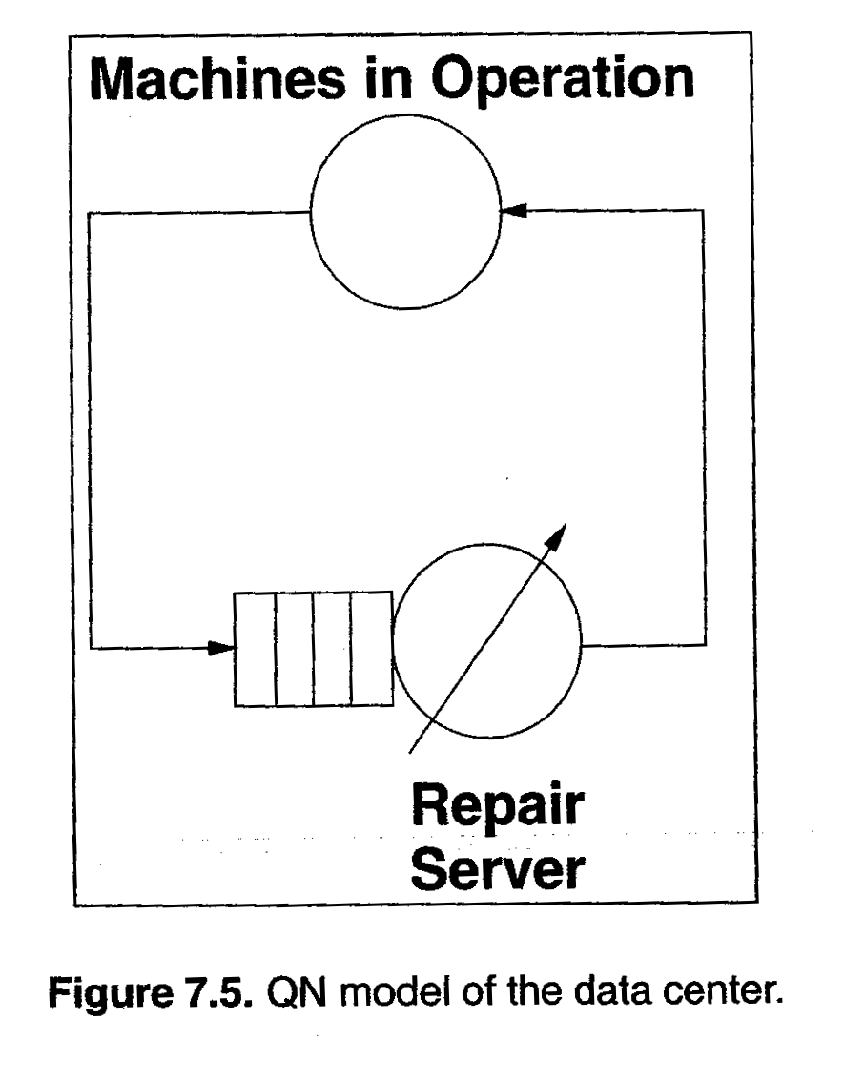
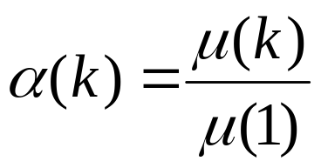
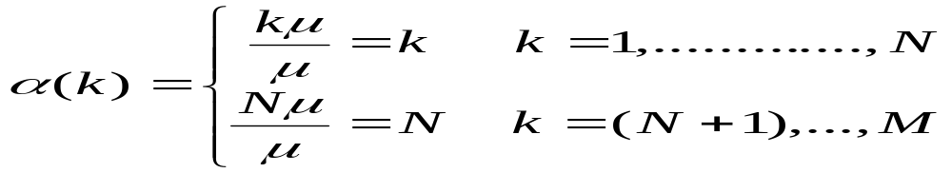
Second Modeling Attempt
~4~
Use MVA method with load-dependent devices for solving this model
required: service rate´multipliers
, k=1,...,M (s.Chp 14)

Slide 38

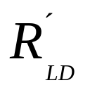
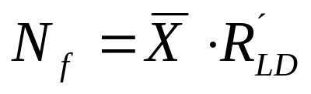
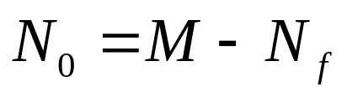
Second Modeling Attempt
~5~
The solution of this MVA model gives us:
average throughput:
average residence time at the LD-device:
= MTTR
Little´s Law to LD device:
av. number of failed machines:
av. number of machines in op.:

Slide 39
A Cost Analysis
C_{p} annual personnel cost
C_{m} annual cost per machine
β constant revenue multiplier
N_{o} average number of machines in operation
M_{min} minimum number of machines that need to be in operation for the data center not to have to pay a penalty
C_{α} cost
R_{α} revenue

Slide 40
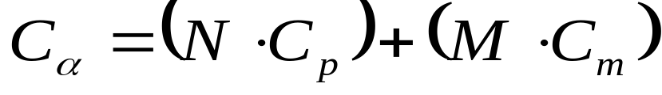
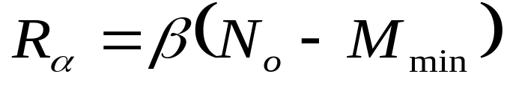
A Cost Analysis
cost:
revenue:
profit:

Slide 41
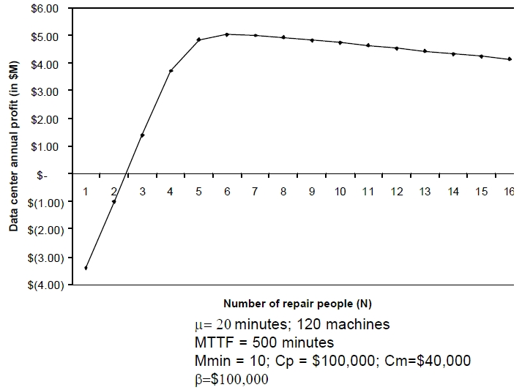
A Cost Analysis

Slide 42
A Cost Analysis
negative profit for low numbers of personnel, because of low machine availability
with more than 6 personnel costs increases more then revenue, thus 6 service personnel are optimal

Slide 43
References
Skripts And Talks Of Menasce CS672_Performance
cs672-07CaseStudy-III-DataCenter.pdf
cs672-03QuantifyingPerformanceModels.pdf
Skript SN1
Haverkort: Computer Communication Systems
Performance Analysis

